Slide 1
It’s Your Money
Recovering From the Holidays
Presented By Travis Waugh

Slide 2
Ghosts of CHRISTMAS PAST (The 1870s)
The first published greeting cards went on sale.
15.8 BILLION DOLLAR INDUSTRY LAST YEAR
Christmas Trees were introduced to the general public, along with manufactured ornaments.
2.5 BILLION DOLLAR INDUSTRY
Santa Claus came to fame in England and America.
FOURTH QUARTER RETAIL DWARFS REST
Introduction of Electric Lights nearly killed the candle industry.
STILL 2 BILLION DOLLARS A YEAR!
Notes:
In the 1870s, everything changed.

Slide 3
Christmas Present
How much does the average American person spend on the holidays?
$690
http://www.mint.com/blog/trends/how-does-your-holiday-spending-compare-to-the-national-average-112011/

Slide 4
AGENDA
THE PAST
What’s done is done. Now what are we going to do about it?
THE FUTURE
It will be here before you know it. How do we want next year to be different?
THE PRESENT
Time for action.

Slide 5
The PAST
Dealing with Holiday Debt
In which we discuss holes… and how to dig out of them.

Slide 6
Types of Debt
Major Credit Cards
Retail Cards
Student Loans
Vehicle Loans
Mortgages
Other Bank Loans
Personal Loans
ALL DEBT IS NOT CREATED EQUAL.
BUT ALL MUST BE PAID.

Slide 7
DEBT FUELS THE HOLIDAY FIRE
Credit Card usage spikes in November and December, with a majority of consumers relying on plastic to achieve their holiday dreams.
46 percent plan to pay off this debt by the end of January, but…
6 Percent were still paying in October!

Slide 8
The Curious Case of Travis P.
Travis P., 37, is still trying to wrangle down debt from more than a decade of Christmases.
The Minnesota resident used to be among the deal-hungry hordes camped outside of Best Buy on Black Friday. One time he scored a new computer, a camcorder and other electronics equipment — “not because we needed it or because we had the money for it, but because it was a good deal.”
Travis thought he was being responsible by paying the minimum required on his credit card bills each month, not realizing that his remaining balance was skyrocketing to over…
$100,000.
http://www.washingtonpost.com/business/economy/shoppers-return-to-credit-to-pay-for-holidays/2011/12/22/gIQAc0NnKP_story.html

Slide 9
The Curious Case of Travis P.
When his lender increased his monthly minimum in 2009, Travis realized he couldn’t afford the payment.
It had ballooned to an amount larger than his mortgage.
“That should’ve been a clue right there that something was out of whack,” he said.
http://www.washingtonpost.com/business/economy/shoppers-return-to-credit-to-pay-for-holidays/2011/12/22/gIQAc0NnKP_story.html

Slide 10
The Curious Case of Travis P.
Travis enrolled in debt management plan with Maryland-based CareOne, and has now paid off half of what he owes and is CREDIT-CARD FREE!
Instead of spending as much as $600 on each of his two kids, he budgets about $100 each for the holidays.
It hasn’t reduced our Christmas enjoyment at all.
- Travis P.
http://www.washingtonpost.com/business/economy/shoppers-return-to-credit-to-pay-for-holidays/2011/12/22/gIQAc0NnKP_story.html

Slide 11
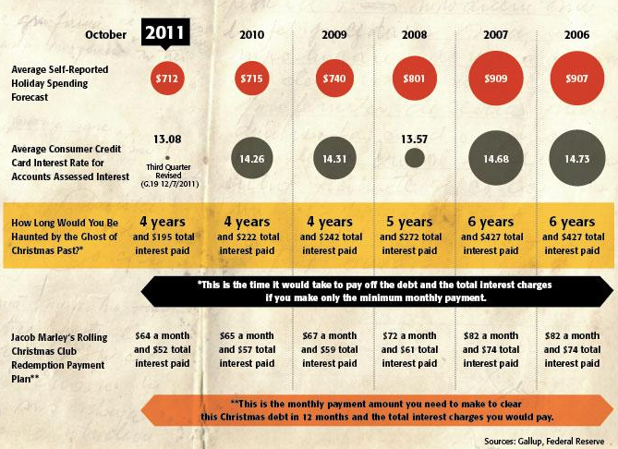

Slide 12
Case Study
Pop-quiz hotshot: You have 200 dollars a month. What do you pay?
VISA BILL
$1,000 Balance
10% APR
$30 minimum due
You pay: ________
MACY’S BILL
$500 Balance
18% APR
$15 minimum due
You pay: ________
$30
$170

Slide 13
The FUTURE
Setting a Smart Target
This time next year, we’ll all be rich geniuses!

Slide 14
How Much Holiday do You Want?
January is the best time to make a budget for next year.
You have all the data you need at hand: receipts, bank statements, and credit cards bills from this year.
Take a long look at what you spent. Where did you get the most bang for your buck? What was wasted?
Make a realistic estimate.
NEXT YEAR I WILL NEED _____________
AND
REMEMBER
IT!
$700

Slide 15
Pick your poison…
Credit Cards | Retail Accounts | Layaway | Cash Money

Slide 16
Pick your poison…
Credit Cards | Retail Accounts | Layaway | Cash Money
+ Convenient + Competitive Interest Rates - May have existing balance - Interest can build quickly

Slide 17
Pick your poison…
Credit Cards | Retail Accounts | Layaway | Cash Money
+ Convenient + Competitive Interest Rates - May have existing balance - Interest can build quickly | + Special Deals and Incentives - High Interest Rates

Slide 18
Pick your poison…
Credit Cards | Retail Accounts | Layaway | Cash Money
+ Convenient + Competitive Interest Rates - May have existing balance - Interest can build quickly | + Special Deals and Incentives - High Interest Rates | + No interest, low or no fees + Reserve Items + No debt - Demands money up front

Slide 19
Pick your poison…
Credit Cards | Retail Accounts | Layaway | Cash Money
+ Convenient + Competitive Interest Rates - May have existing balance - Interest can build quickly | + Special Deals and Incentives - High Interest Rates | + Low interest, low or no fees + Reserve Items + No debt - Demands money up front | + No Fees or Interest + More Buying Power + Satisfaction - Opportunity Costs

Slide 20
The Present
Working Toward Your Goals
There’s no time like it.

Slide 21
WHY SAVE?
LIQUID SAFETY NET
Money for whenever you might need it.
Experts recommend enough for six months expenses.
INVESTING
Money set aside for your long term goals.
Try to manage 10% a month.
SHORT TERM GOALS
Money to cover a down payment on a house, a big purchase, or experiences like vacations and holidays.

Slide 22
SAVE YOURSELF!
SAVINGS
Income
Expenses

Slide 23
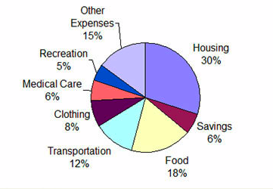
Let’s Mess With Expenses
How should the average 20 something spend their money?
#3
#1
#7
#6
So, what can we do to save more?
#5
#4
#2

Slide 24
Make a Realistic Budget
Fixed Expenses (Rent, Student Loans, Car, Insurance, etc.)
+ Average Variable Expenses (Food, Utilities, Gas, etc.)
Average Monthly Expenses
Monthly Income
- Average Monthly Expenses
Disposable Income

Slide 25
Indisposed?
What if you have no money left at the end of every month?
Look at your expenses line by line.
Make a list of all possible Trade-Offs and their total value.
Set a target amount.
Make the trade!

Slide 26
Let's Start Disposing
Disposing of income is all too easy. Will you…
BUY
INVEST
PAY-OFF
or
SAVE

Slide 27
Stick to the Plan
A savings plan is worthless. Action counts.
Got a number in mind?
Make it automatic.
The best way is to talk to your bank and setup an automatic transfer to a savings account.

Slide 28
Case Study
Pop-quiz hotshot: You have 500 dollars in disposable income. What do you do?
SAVINGS PLAN
$1,250 Saved
$250 auto-deposit per month
You: ________
CREDIT CARD BILL
$2000 Balance
15% APR
$20 minimum due
You pay: ________

Slide 29
Seize the Momentum
It’s all about cycles, so get peddling…
More Savings
Less Debt
More to Save
Even less debt!
Start here!

Slide 30
Go Forth
And Prosper!
Don’t wait for perfection.
Start saving today!
Travis Waugh

